Slide 1

HEARTBEAT SENSOR
EC ID:1900224
Guided by
PROF. NEHA GUPTA
DEPT.OF ECE
TEAM MEMBERS
1.TRIPURANENI MEGHANA[19BCE7628]
2.GHANTA NEHA[19BCE7412]
3.MARINENI NITHIN[19BCE7408]
4.PARUCHURI SUDHEER BABU[19BCE7581]
5.CHITTEMLAKSHMINARASIMHA MANIKANTA[19BCE7086]
6.JAKA PRASANTH[19MIS7075]

Slide 2
Agenda
Completed working prototype
Architecture/Design circuits
Objectives meeting outcome
Results with Screenshots
Future improvements can be made
references

Slide 3
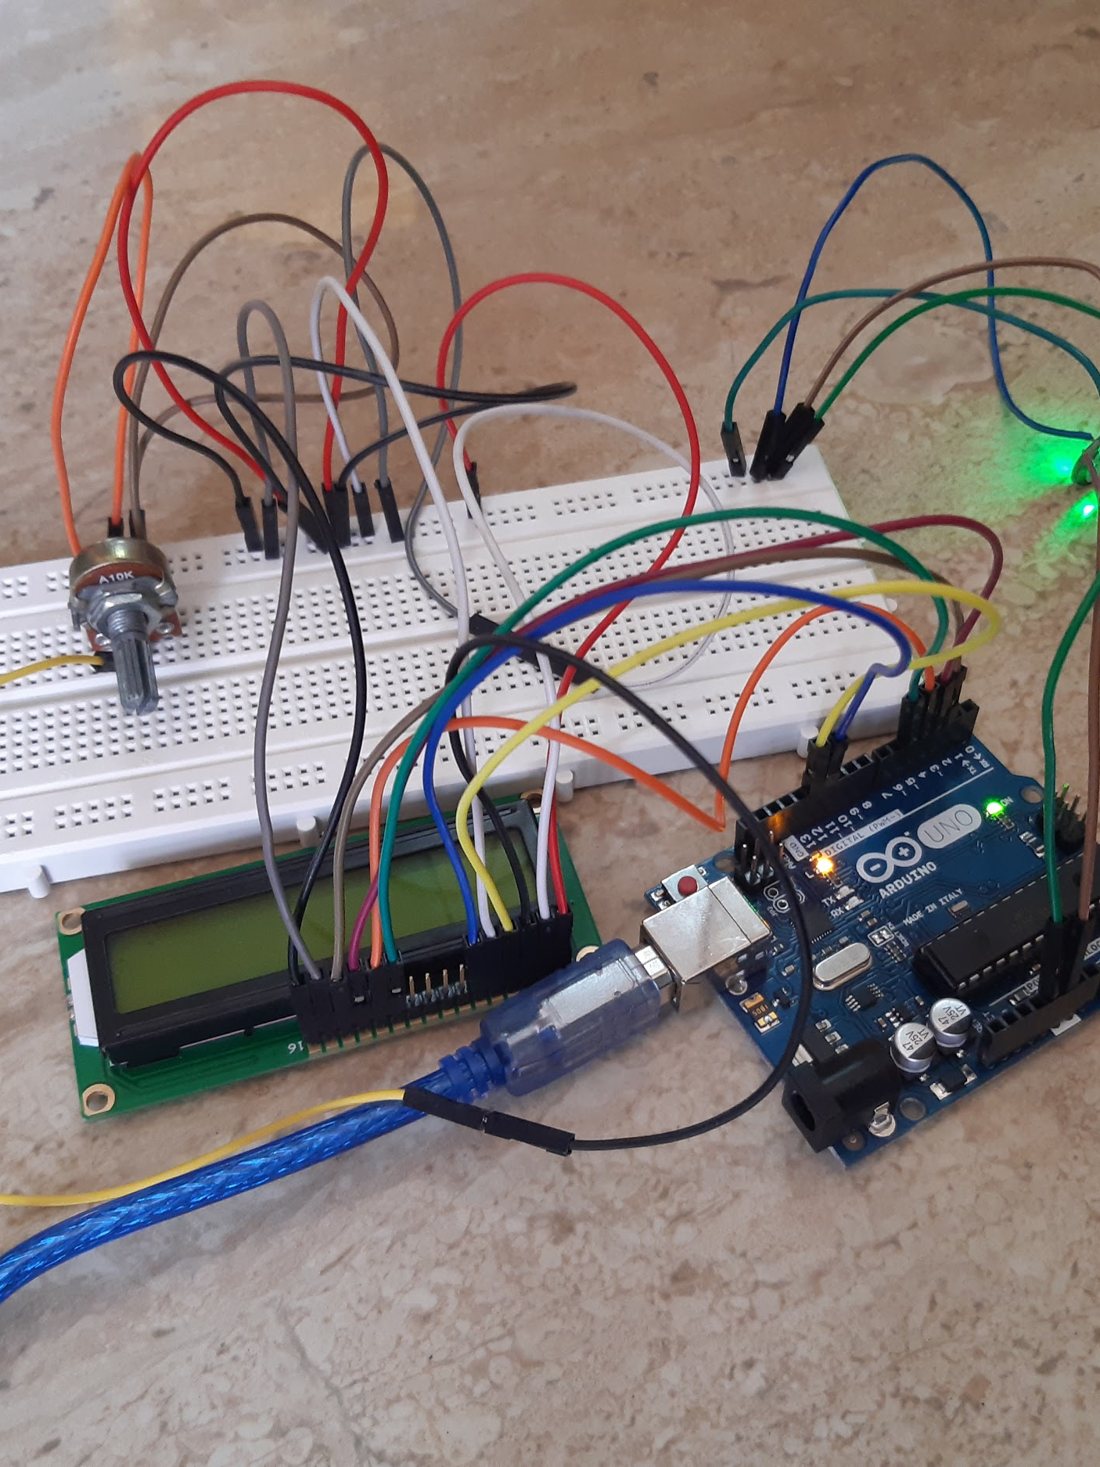
Completed working prototype

Slide 4
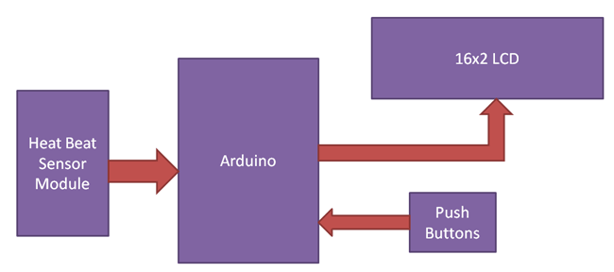
Architecture/Design circuits

Slide 5
Objectives meeting outcome
The following objectives has been accomplished by our working prototype
As we mentioned before our objectives were as follows
The objective of project is to monitor body heart rate and display the same to doctor
In addition, the project aims to develop a common platform to provide a means of communication between the doctor and patient, where the doctor can see the patient's daily records
Our heart beat sensor is used in wrist watches,smart phones .it is portable can be carried anywhere
It can be used by atheletics ,students,patients e.t.c

Slide 6
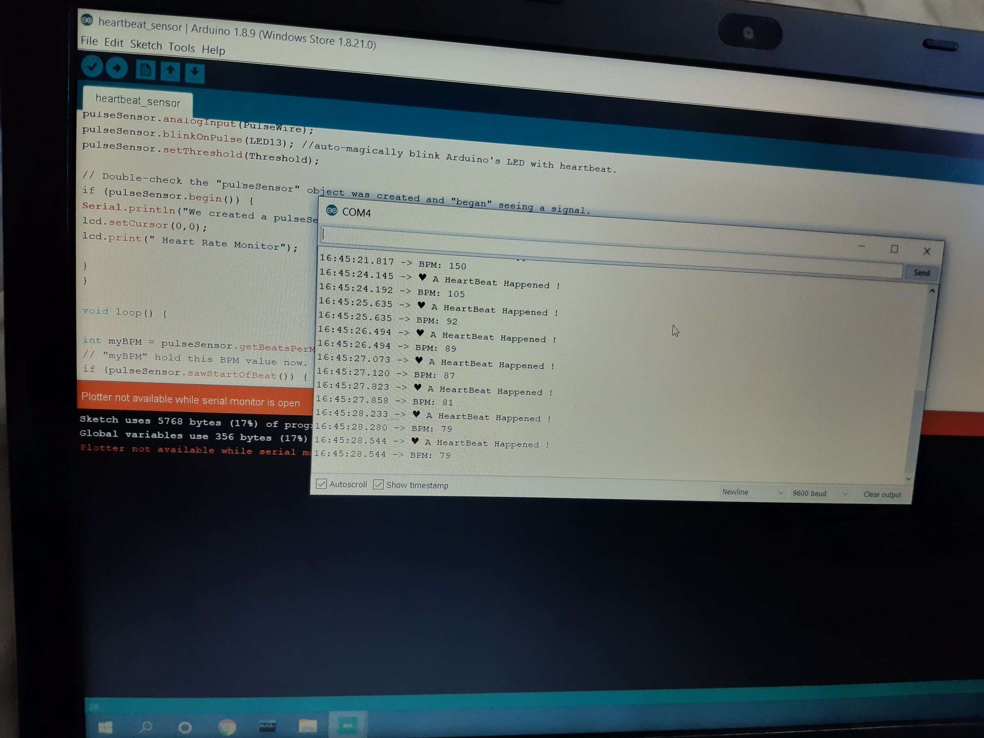
Results with Screenshots

Slide 7
Future improvements can be made
The current version of the Processing application displays the near-real-time PPG waveform and heart rate but does not record anything. There is a lot of room for improvements.
Logging heart rate measurements and PPG samples along with the time-stamp information available from the PC
Beeping sound alarm for heart rates below or above threshold
Heart rate trend over time, etc.

Slide 8
References
www.electronicshub.org
www.Cricuitdigest.com

Slide 9
THANK YOU

